Slide 1
Comparison of the Spike Protein in Various Coronaviruses Through Analysis of Different Phylogenetic Methods
Presented By: Sara Bell, Hitesh Kumar, Rashi Raghulan
Notes:
Maybe we should have spike protein in title?

Slide 2
Outline
Coronaviruses
Spike Protein
Hierarchical Clustering
Explanation of Online Phylogenetic Tools
Demo and Explanation Of Our Phylogenetic Tool
Discussion and Conclusion

Slide 3
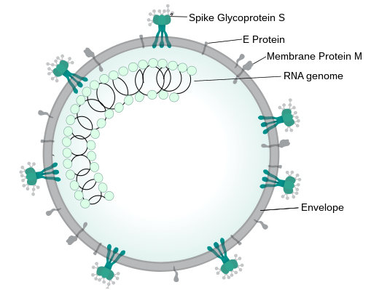
Coronaviruses
RNA viruses with outer lipid bilayer called viral envelope
Higher mutation rate than DNA viruses because they use RNA polymerase (lower proofreading ability)
Higher genetic diversity (limits effectiveness to vaccines against them)

Slide 4
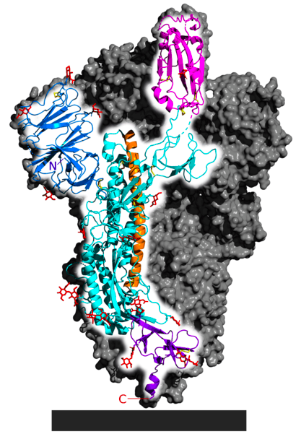
Spike (S) Glycoprotein
Spike protein are found in enveloped viruses (e.g. coronaviruses)
S1 and S2, with a total length between 1200-1400 amino acids.
S2 region responsible for allowing viral RNA entry to host cell
S2 region is highly conserved among coronaviruses
Notes:
Cryo-electron microscopy structure of a SARS-CoV-2 spike protein trimer in the pre-fusion conformation, with a single monomer highlighted. The S1 NTD is shown in blue and the S1 CTD (which serves as the receptor-binding domain) is shown in pink. Helices show in orange and cyan form parts of S2 that will undergo conformational changes during fusion. The black bar at the bottom indicates the position of the viral membrane. From PDB: 6VSB​.[13]

Slide 5
Phylogeny
The study of the evolutionary relationship between or among species
Computational algorithms take nucleic acid/amino acid sequence as input
Output phylogenetic tree (binary tree)
Orthocoronavirinae, the subfamily made up of coronaviruses, consists of four genera:
Alphacoronavirus, Betacoronavirus, Gammacoronavirus and Deltacoronavirus
Detected in mammals and avians with minimal symptoms, however, in humans these viruses are known to cause respiratory infections

Slide 6
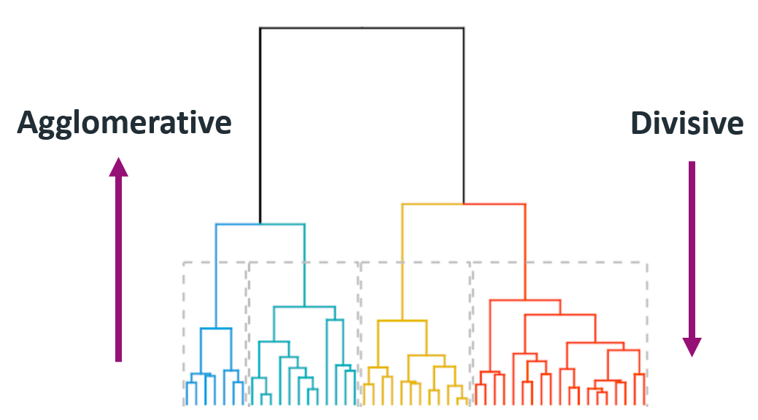
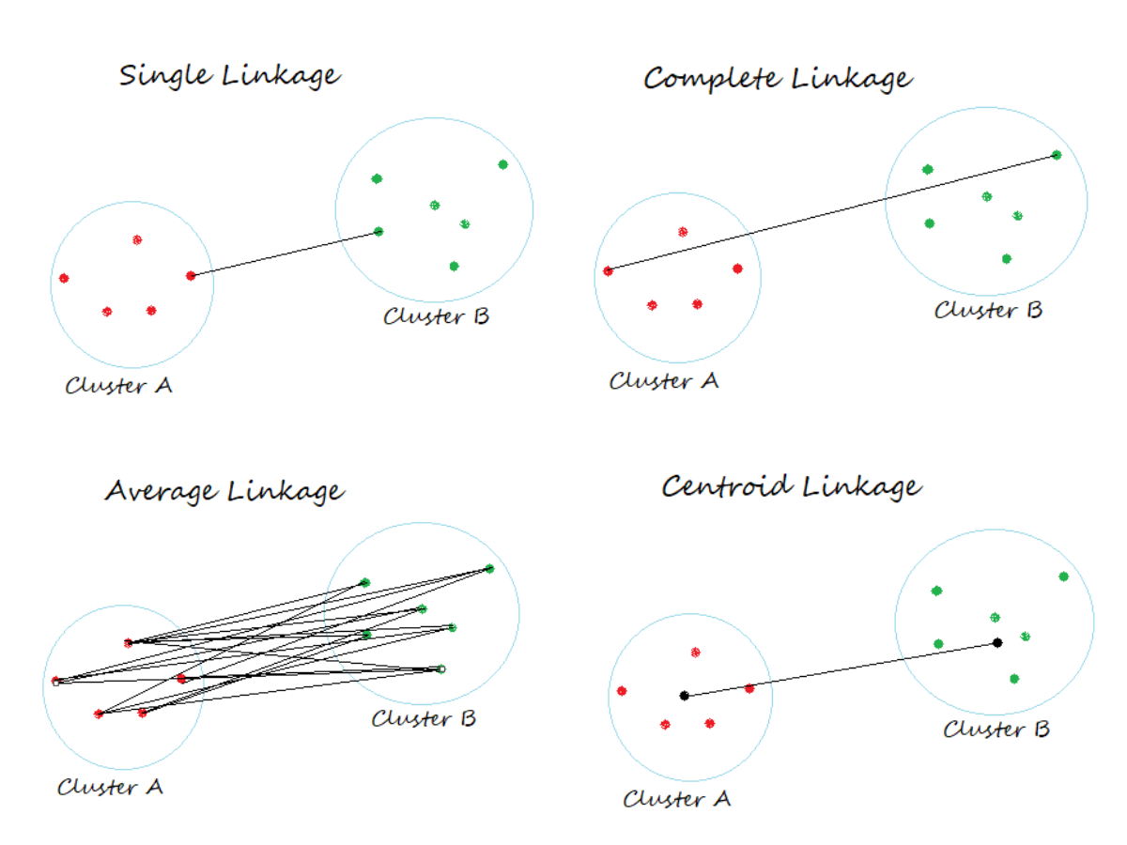
ML – What is Hierarchical Clustering?
Notes:
Bottom-up
https://ars.els-cdn.com/content/image/3-s2.0-B9780128008911000068-f06-08-9780128008911.jpg
https://miro.medium.com/max/1039/0*afzanWwrDq9vd2g-
So the machine learning techniques that we are exploring is hierarchical clustering.
It is an algorithm that utilizes unsupervised machine learning that groups similar the species which are made a cluster. In the image, we can see that there are 4 clusters and if you cut the tree higher you can get two clusters and more clusters if you cut lower.
These clusters can be created through the 4 linkages explained in the right. The clustering linkage that we are looking at mainly is average linkage which is used in the UPGMA method.

Slide 7
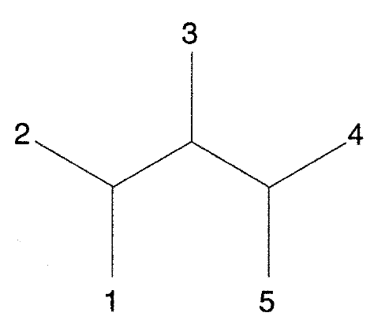
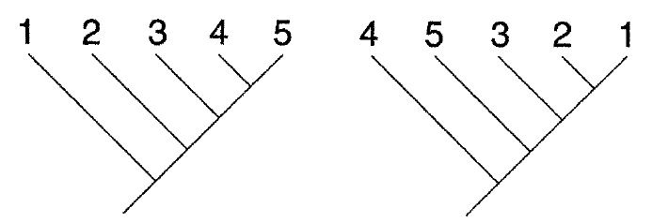
Phylogenetic Tree
Binary tree that illustrates the relationships found by the phylogenetic analyses conducted
Rooted (UPGMA)
single node from which all other nodes branch out from
Unrooted (Neighbor Joining)
no primary node so it is unclear from which all the other branches derived from
Notes:
Rooted vs Unrooted - Sara

Slide 8
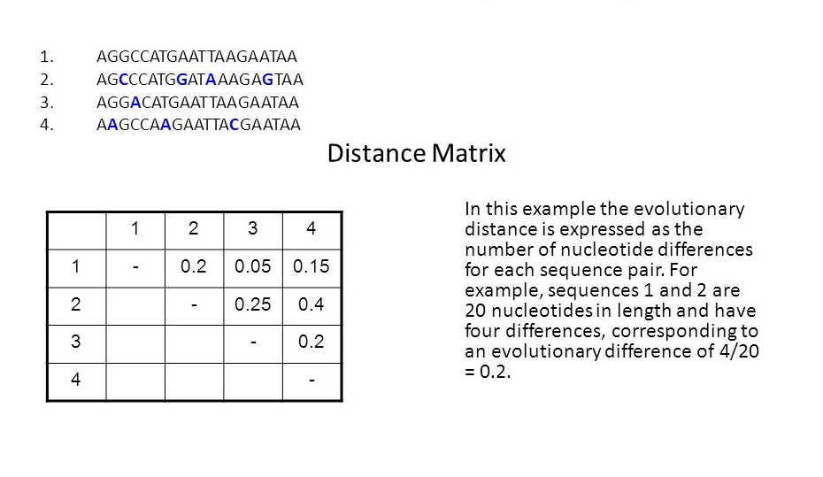
Pairwise Distance Matrix
Notes:
https://slideplayer.com/slide/6845534/23/images/31/UPGMA.jpg

Slide 9
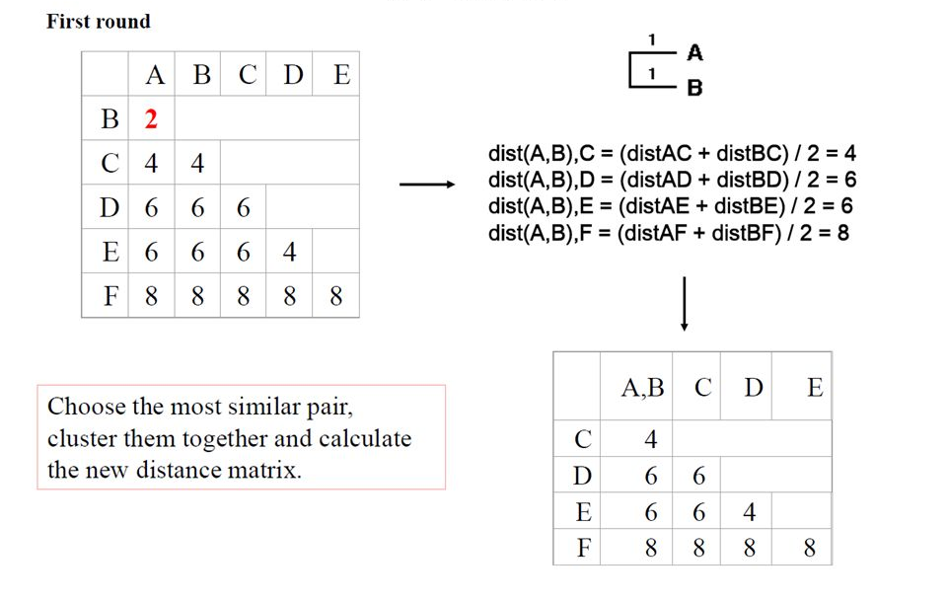
Hierarchical Clustering – UPGMA
Notes:
Hierarchical Clustering with Upgma and NJ – Rashi + Bootstrap
https://slideplayer.com/slide/6845534/23/images/28/UPGMA.jpg

Slide 10
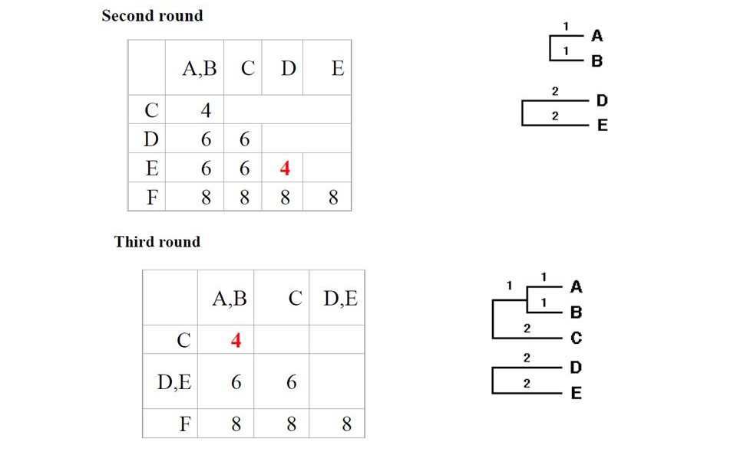
Hierarchical Clustering – UPGMA
Notes:
Hierarchical Clustering with Upgma and NJ – Rashi + Bootstrap
https://slideplayer.com/slide/6845534/23/images/28/UPGMA.jpg

Slide 11
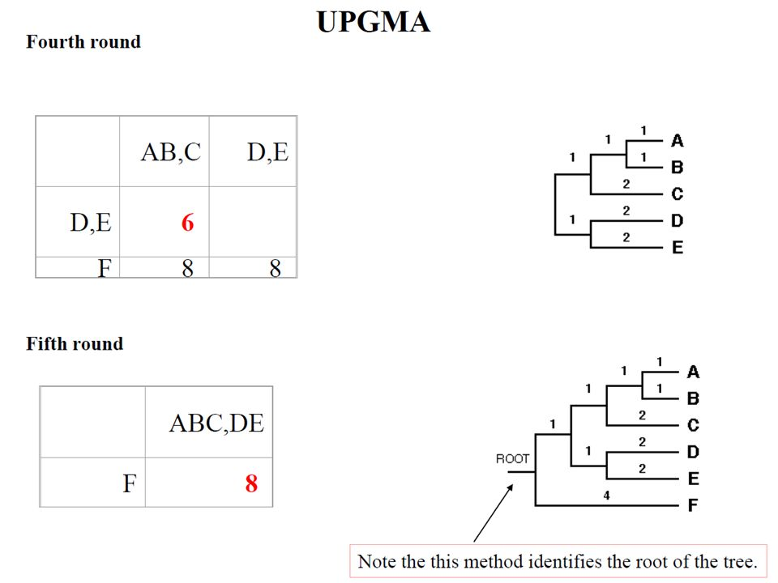
Hierarchical Clustering – UPGMA
Notes:
Hierarchical Clustering with Upgma and NJ – Rashi + Bootstrap
https://slideplayer.com/slide/6845534/23/images/28/UPGMA.jpg

Slide 12

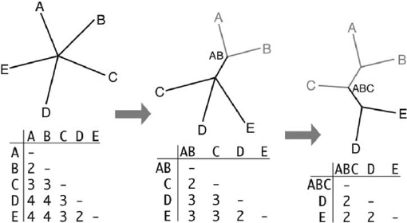
Neighbor Joining
Notes:
https://www.researchgate.net/profile/Michael-Dunn-7/publication/233577979/figure/fig2/AS:300102607491088@1448561445747/Neighbor-Joining-algorithm-start-from-a-star-phylogeny-left-find-the-nearest-pair-of.png

Slide 13
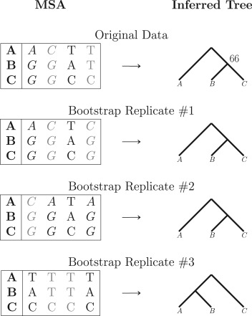
Bootstrap Scores
Notes:
https://ars.els-cdn.com/content/image/3-s2.0-B9780128096338202598-f20259-01-9780128114148.jpg

Slide 14
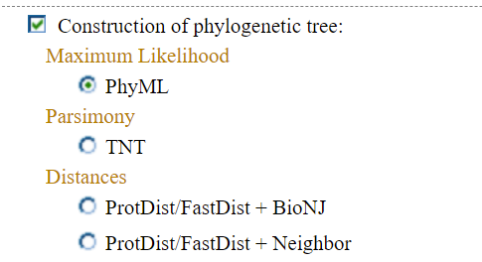
Online Tool — Phylogeny.fr
Notes:
2 Tools – Rashi

Slide 15
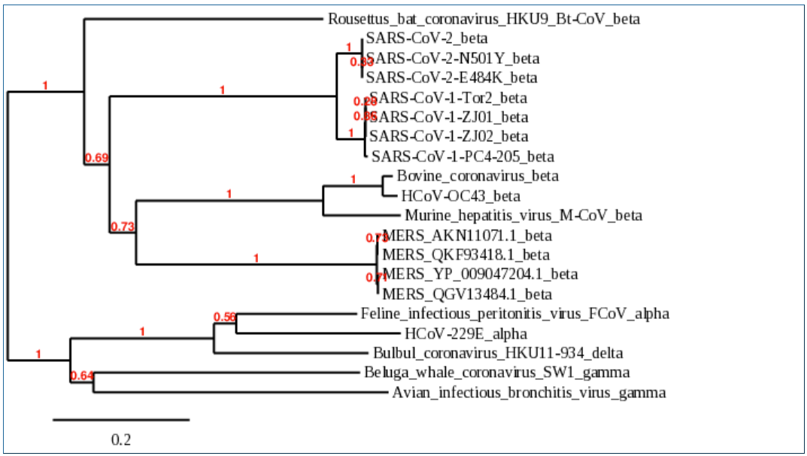
ProtDist/FastDist + Neighbor Phylogenetic Alignment
bootstrap average: 0.8072

Slide 16
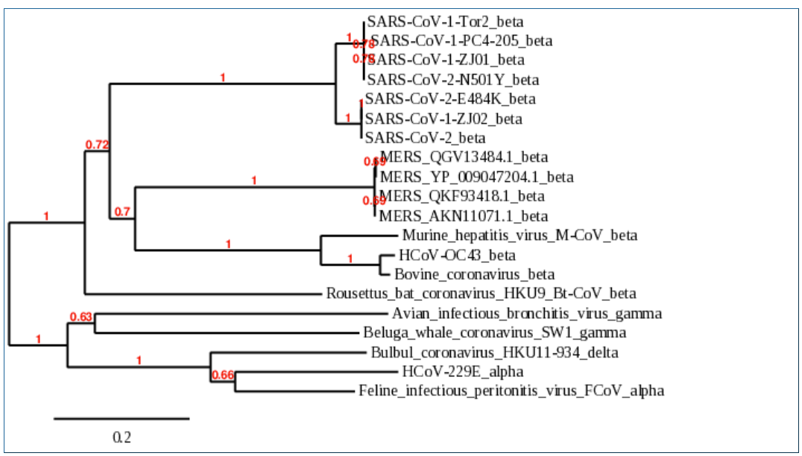
ProtDist/FastDist + BioNJ Phylogenetic Alignment
bootstrap average: 0.86944

Slide 17
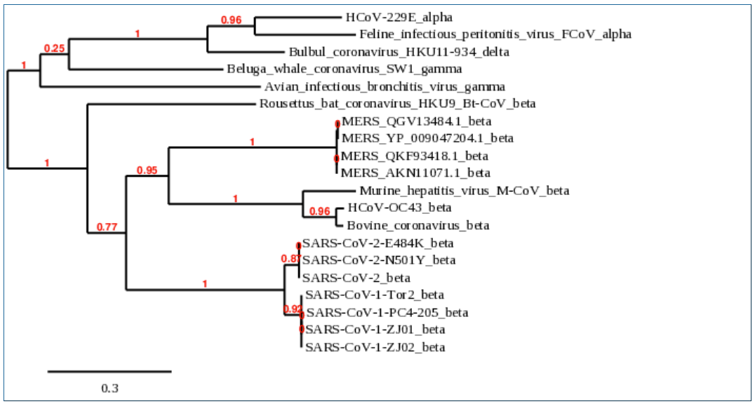
PhyML Phylogenetic Alignment from Phylogeny.fr
bootstrap average: 0.6489

Slide 18
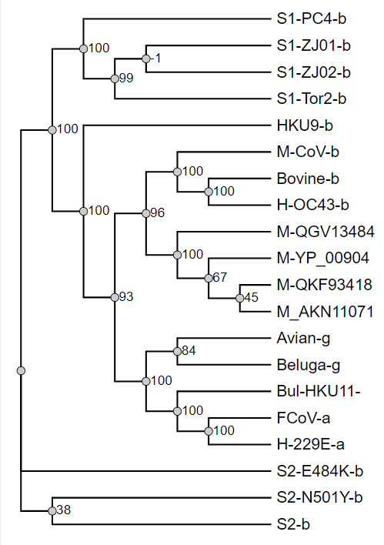
PhyML Phylogenetic Alignment from ATGC: Montpelier – Online Tool
bootstrap average: 0.8359

Slide 19
Demo on Jupyter Notebook
Switching to Jupyter Notebook →
Notes:
Hitesh Code on UPGMA and NJ

Slide 20
Model
Risler Protein model : This model uses techniques used to measure similarity between protein sequences. It superimposed in three dimensions the Cª carbon topological backbones of the two protein sequences to be examined. This model’s finding and features are being modelled in the BioPython Package and we can use them correctly.
Identity Protein model : This model uses 1-1 mapping of amino acids and this parameter is widely used one. This is also the default value of the package of BioPython due to its popularity.
Notes:
Hitesh – Model Discussion

Slide 21
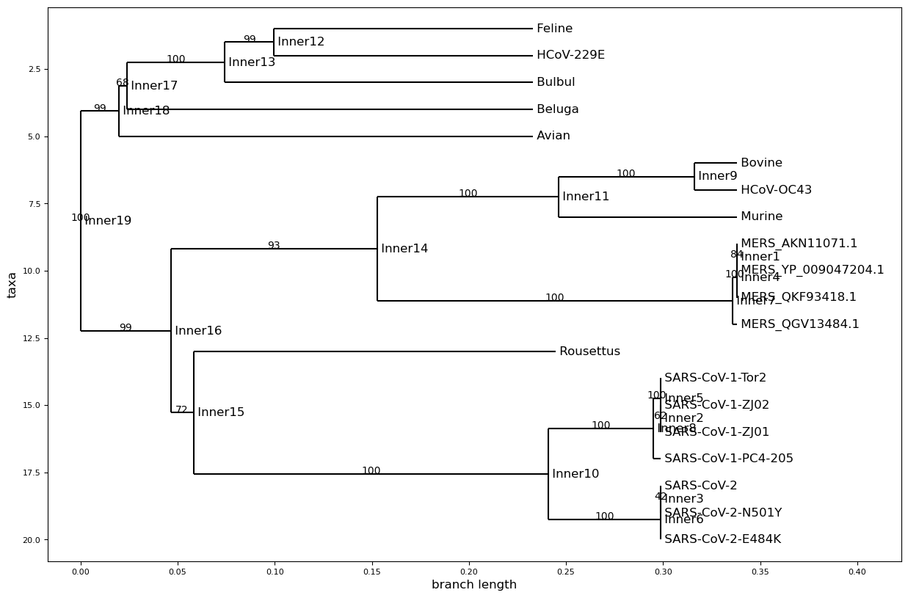
Phylogenetic tree with Model = risler and method = upgma with bootstrap average score of 91.052

Slide 22
Alpha + Beta
Betacoronavirus
SARS-CoV-2, MERS, SARS-CoV (most likely origin bats)
Another human coronavirus (HCoV OC43 common cold type)
Bat coronavirus
Bovine (cattle) coronavirus (causes calf enteritis)
Murine coronavirus (mouse) (heavily studied)
Alphacoronavirus
Another human coronavirus (H-CoV 229E common cold type)
Feline coronavirus
Notes:
Alpha + Beta + Gamma - Sara

Slide 23
Gamma + Delta
Gammacoronavirus
Avian coronavirus (mucus accumulation)
Beluga whale coronavirus (pulmonary disease and terminal acute liver failure)
Deltacoronavirus
Bulbul coronavirus (bird)

Slide 24
Thank you
Q&A
References On the Next Three Slides

Slide 25
References
[1] J. Cui, F. Li and Z. Shi, “Origin and evolution of pathogenic coronaviruses,” Nature Reviews Microbiology, vol. 17, pp. 181-192, Dec. 2018. [Online].
Available: doi: 10.1038/s41579-018-0118-9
[2] R. Sanjuan, M.R. Nebot, N. Chirico, L.M. Mansky, and R. Belshaw, “Viral mutation rates,” J. Virol., vol. 84, no. 19, pp. 9733-9748, Oct. 2010. [Online]. Available: doi: ﻿10.1128/jvi.00694-10
[3] D.W. Klein, L.M. Prescott, and J. Harley, Microbiology, 2nd ed., Dubuque, IA, Wm C. Brown, 1993.
[4] D.A. Steinhauer and J.J Holland, “Rapid evolution of RNA viruses,” Annu. Rev. Microbiol., vol. 41, Oct. 1987. [Online]. Available: doi: ﻿10.1146/annurev.micro.41.1.409
[5] K.S. Park, X. Sun, M.E. Aikins, and J.J. Moon, “Non-viral COVID-19 vaccine delivery systems,” Adv. Drug Deliv. Rev., vol. 169, pp. 137-151. Feb. 2021. [Online]. Available: doi: 10.1016/j.addr.2020.12.008
[6] L. Du et al., “The spike protein of SARS-CoV– a target for vaccine and therapeutic development,” Nature Reviews Microbiology, vol. 7, pp. 226-236, Feb. 2009 [Online]. Available: doi:1038/nrmicro2090
[7] J.M. White, S.E. Delos, M. Brecher, and K. Schornberg, “Structures and mechanisms of viral membrane fusion proteins: multiple variations and common theme,” Critical Reviews in Biochemistry and Molecular Biology, vol. 43, no. 3, pp. 189-219. Oct. 2008. [Online]. Available: doi: ﻿10409230802058320
[8] F. Li, “Structure, function, and evolution of coronavirus spike proteins,” Annual Review of Virology, vol. 3, pp. 237-261, Aug. 2016. [Online]. Available: doi: 10.1146/annurev-virology-110615-042301
[9] C. Zhu et al., “Molecular biology of the SARS-CoV-2 spike protein: a review of current knowledge,” Journal of Medical Virology, vol. 93, no. 10, pp. 5729 5741, Jun. 2021. [Online]. Available: doi: 10.1002/jmv.27132
[10] J. P. Huelsenbeck, J. P. Bollback, and A.M. Levine, “Inferring the root of a phylogenetic tree”, Syst. Biol. vol. 51, no. 1, pp. 32-43. Jan. 2002. [Online]. Available: doi:10.1080/106351502753475862

Slide 26
References
[11] R.R Sokal, and C.D. Michener, “A statistical method for evaluating systematic relationships,” University of Kansas Science Bulletin, vol. 38, no. 22, pp. 1409-1438. Mar. 1958.
[12] N. Saitou and M. Nei, “The neighbor-joining method: a new method for reconstructing phylogenetic trees,” Molecular Biology and Evolution, vol. 4, no. 4, pp. 406-425, Jul. 1987. [Online]. Available: doi: 10.1093/oxfordjournals.molbev.a040454
[13] J. Rizzo and E.C. Rouchka, “Review of phylogenetic tree construction,” Bioinformatics Review, 2007.
[14] H. Lv, W. Zhou, and C. Zhou, “A discrete particle swarm optimization algorithm for phylogenetic tree reconstruction,” IEEE, Aug. 2004. [Online]. Available: doi: 10.1109/ICMLC.2004.1382252
[15] M. Křivánek, J. Morávek, “NP-hard problems in hierarchical-tree clustering,” Acts Informatics, vol. 23, no. 3, pp. 311-323. Jun. 1986. [Online]. Available: doi: 10.1007/BF00289116
[16] F. Corpet, “Multiple sequence alignment with hierarchical clustering,” Nucleic Acids Res., vol. 16, no. 22, pp. 10881–10890, 1988. [Online]. Available: doi: https://pubmed.ncbi.nlm.nih.gov/2849754

Slide 27
References
[17] S. Kaur, H. S. Sohal, and R. Cheema, “Implementing UPGMA and NJ method for phylogenetic tree construction using Hierarchical clustering,” 2013. [Online]. Available: doi: https://www.semanticscholar.org/paper/Implementing-UPGMA-and-NJ-Method-For-Phylogenetic-Kaur-Sohal/3643ab7798acb94ba02ad86887a49ebf9d42b8d9#paper-header
[18] “ML,” GeeksforGeeks, 19-Jul-2019. [Online]. Available: doi: https://www.geeksforgeeks.org/ml-types-of-linkages-in-clustering/. [Accessed: 09-May-2022].
[19] [Online]. Available: doi: https://editor.analyticsvidhya.com/uploads/40351linkages.PNG
[20] J. Felsenstein, “Evolutionary trees from DNA sequences: a maximum likelihood approach,” J. Mol. Evol., vol. 17, no. 6, pp. 368–376, 1981. [Online]. Available: doi: https://link.springer.com/article/10.1007/BF01734359
[21] S. Guindon, J.-F. Dufayard, V. Lefort, M. Anisimova, W. Hordijk, and O. Gascuel, “New algorithms and methods to estimate maximum-likelihood phylogenies: assessing the performance of PhyML 3.0,” Syst. Biol., vol. 59, no. 3, pp. 307–321, 2010. [Online]. Available: doi: https://academic.oup.com/sysbio/article/59/3/307/1702850
[22] O. Gascuel, “BIONJ: an improved version of the NJ algorithm based on a simple model of sequence data,” Mol. Biol. Evol., vol. 14, no. 7, pp. 685–695, 1997. [Online]. Available: doi: https://pubmed.ncbi.nlm.nih.gov/9254330/
[23] C. A. de M. Russo and A. P. Selvatti, “Bootstrap and rogue identification tests for phylogenetic analyses,” Mol. Biol. Evol., vol. 35, no. 9, pp. 2327–2333, 2018. [Online]. Available: doi: https://academic.oup.com/mbe/article/35/9/2327/5034460

